Slide 1



AW-Report-Final_First
View in Power BI
Last data refresh:
5/1/2021 3:46:49 AM UTC
Downloaded at:
7/8/2021 10:07:21 AM UTC

Slide 2
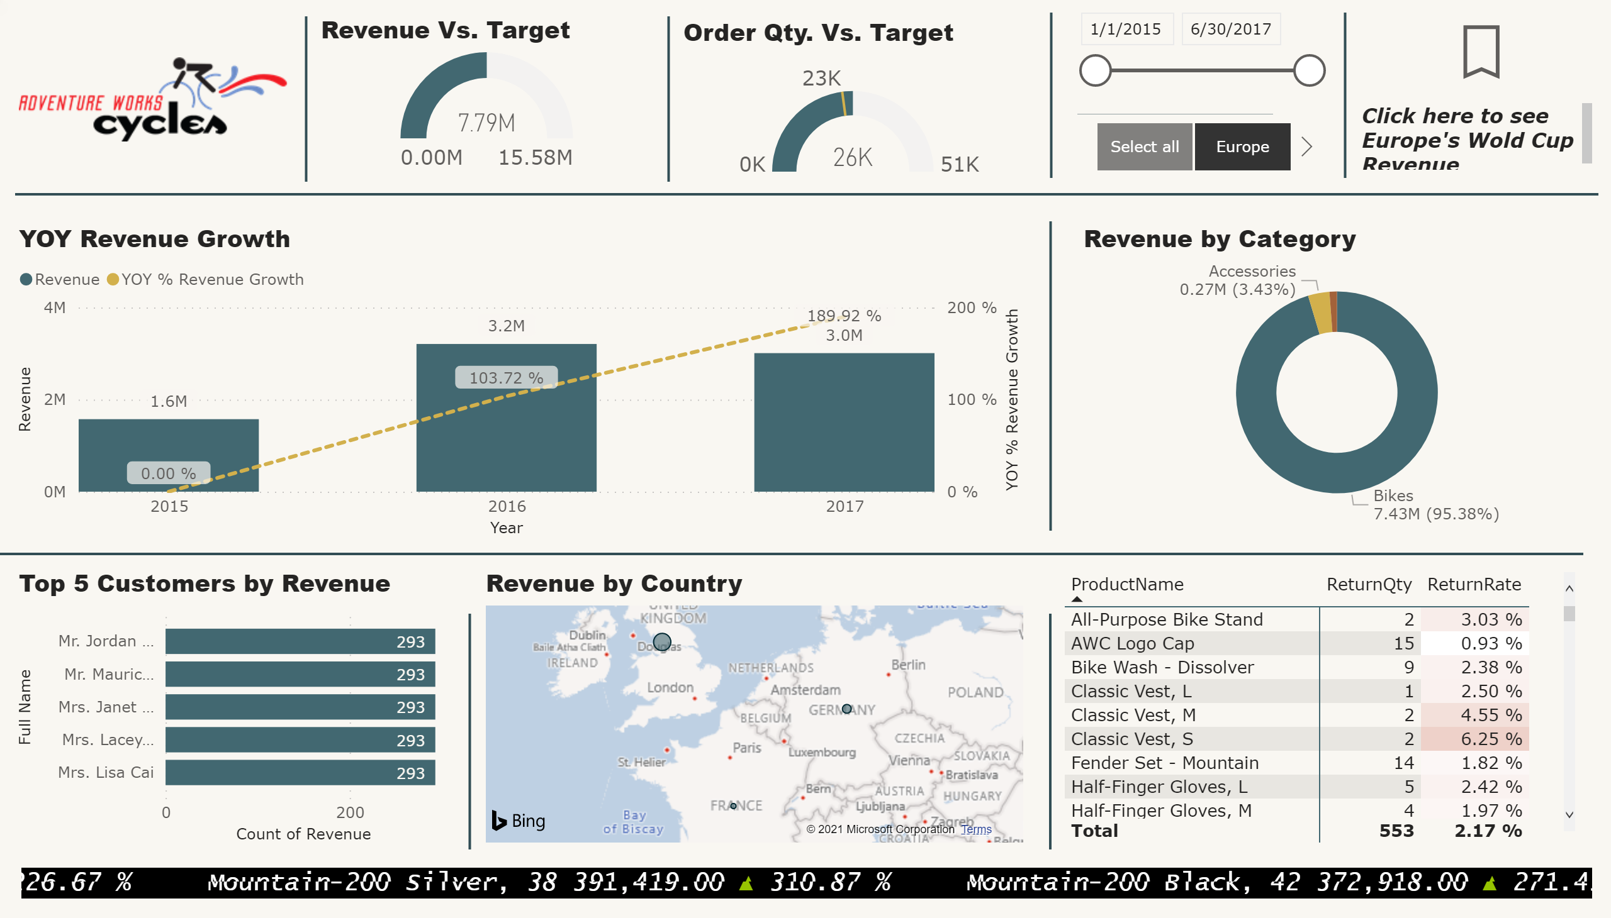
Top Line repport
Notes:
image
No alt text provided.
YOY Revenue Growth
No alt text provided.
Revenue by Category
No alt text provided.
shape
No alt text provided.
shape
No alt text provided.
shape
No alt text provided.
Top 5 Customers by Revenue
No alt text provided.
shape
No alt text provided.
map
No alt text provided.
shape
No alt text provided.
pivotTable
No alt text provided.
shape
No alt text provided.
Revenue Vs. Target
No alt text provided.
shape
No alt text provided.
shape
No alt text provided.
Order Qty. Vs. Target
No alt text provided.
slicer
No alt text provided.
shape
No alt text provided.
slicer
No alt text provided.
ScrollingTextVisual1448795304508
No alt text provided.
shape
No alt text provided.
actionButton
No alt text provided.
textbox
No alt text provided.

Slide 3
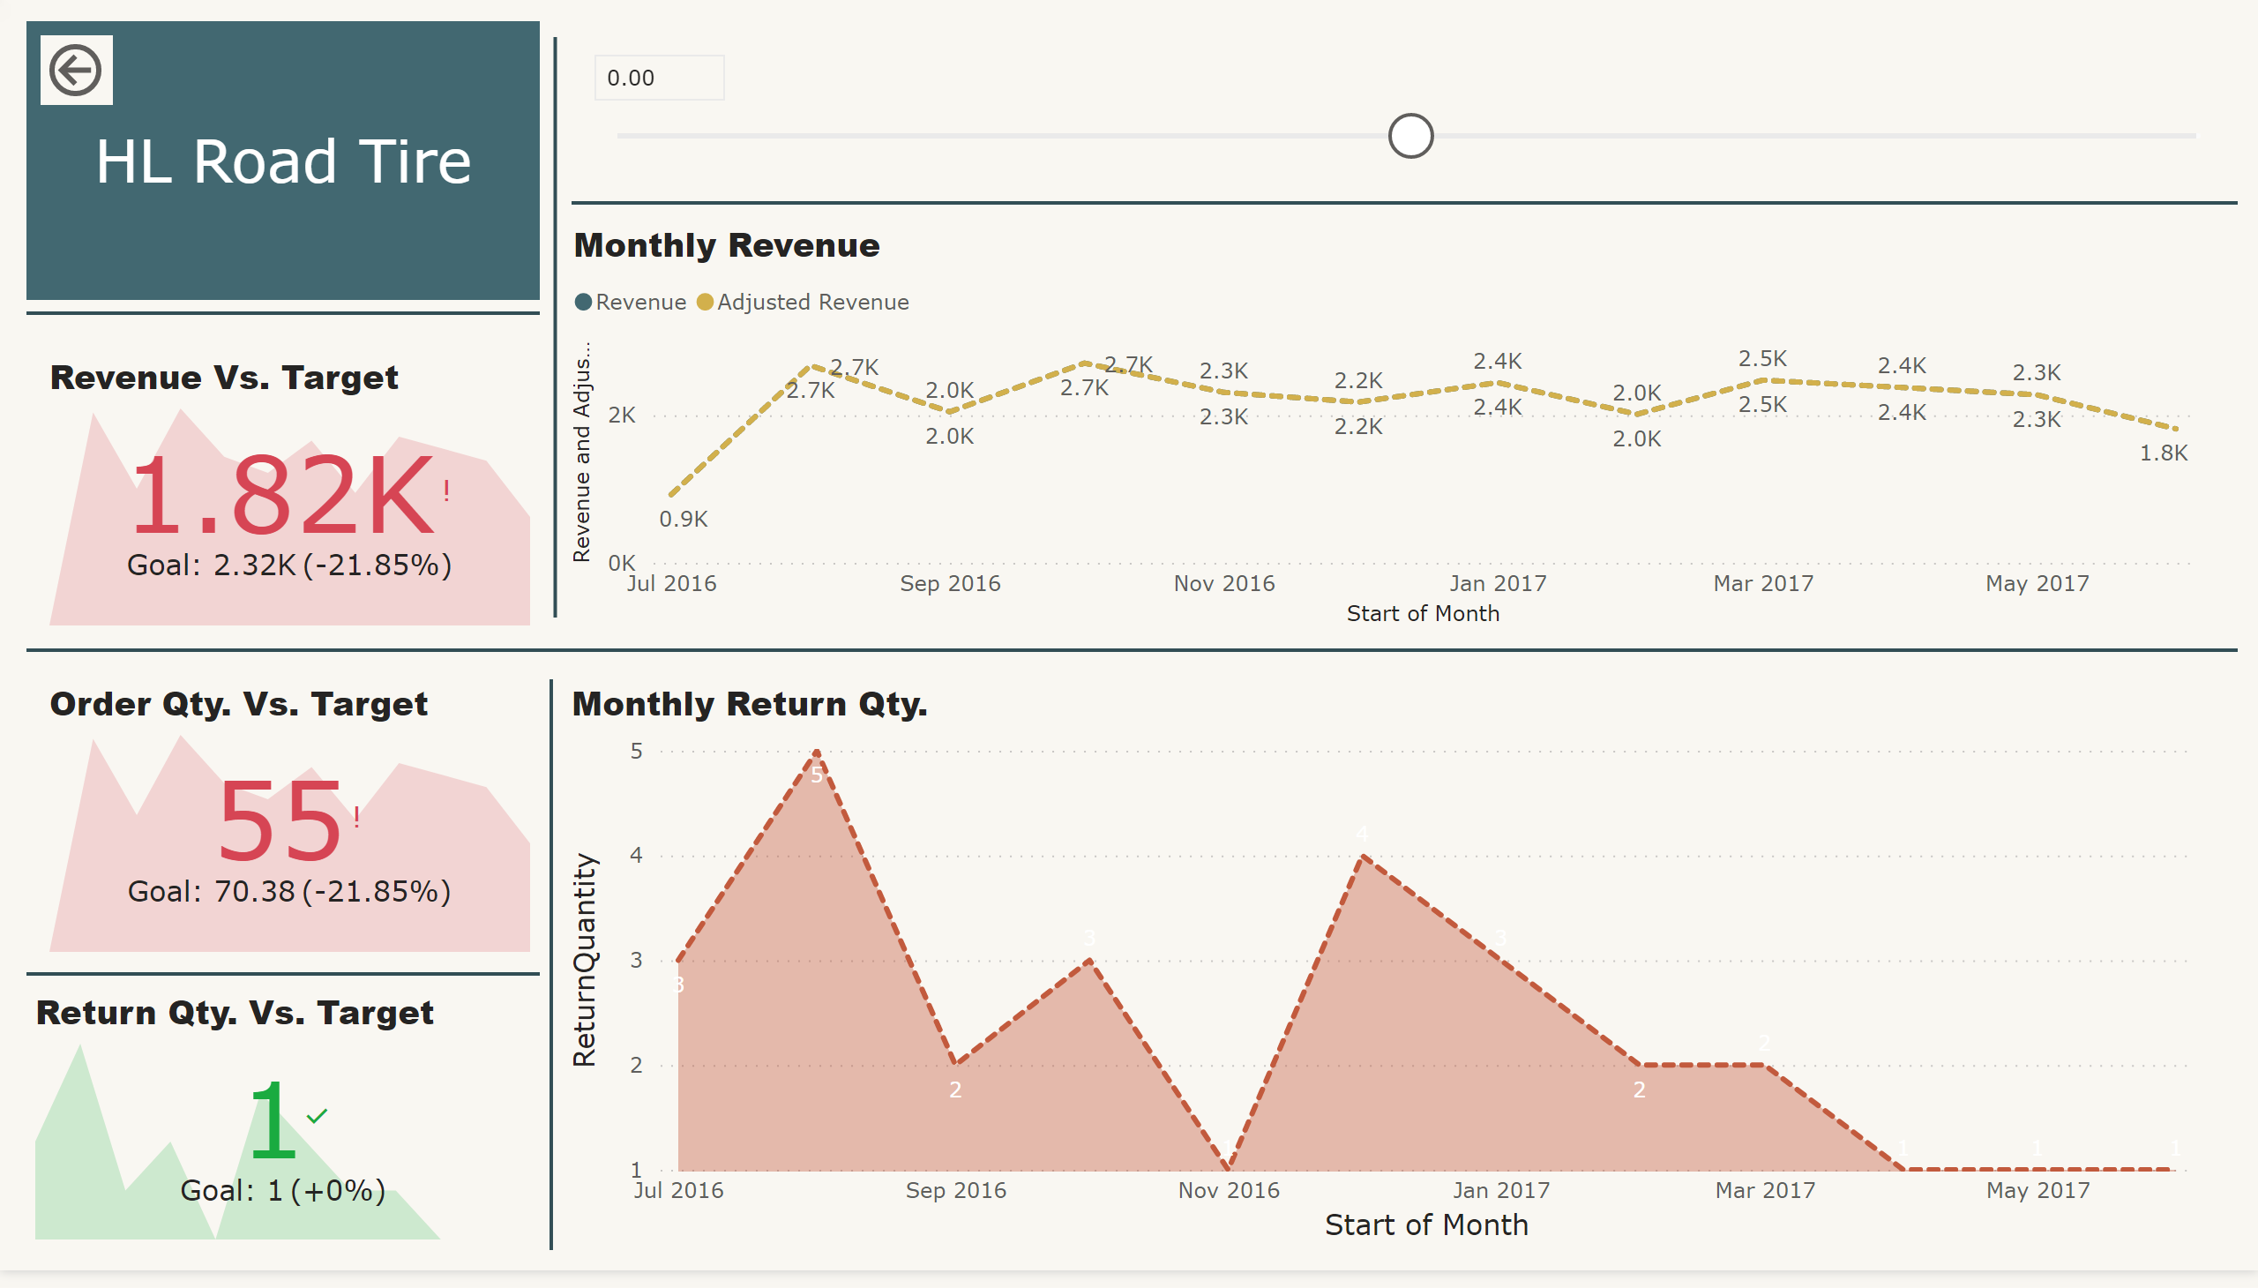
Product Details
Notes:
Monthly Revenue
No alt text provided.
Monthly Return Qty.
No alt text provided.
shape
No alt text provided.
shape
No alt text provided.
shape
No alt text provided.
Revenue Vs. Target
No alt text provided.
shape
No alt text provided.
Order Qty. Vs. Target
No alt text provided.
shape
No alt text provided.
Return Qty. Vs. Target
No alt text provided.
actionButton
No alt text provided.
card
No alt text provided.
slicer
No alt text provided.
shape
No alt text provided.

Slide 4
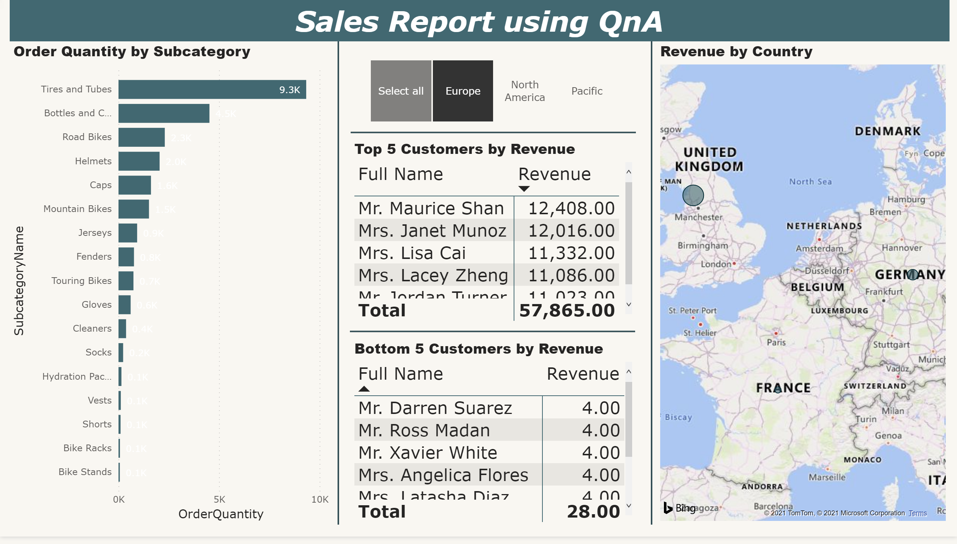
NLQ
Notes:
Order Quantity by Subcategory
No alt text provided.
shape
No alt text provided.
Top 5 Customers by Revenue
No alt text provided.
shape
No alt text provided.
Bottom 5 Customers by Revenue
No alt text provided.
shape
No alt text provided.
map
No alt text provided.
textbox
No alt text provided.
shape
No alt text provided.
slicer
No alt text provided.

Slide 5
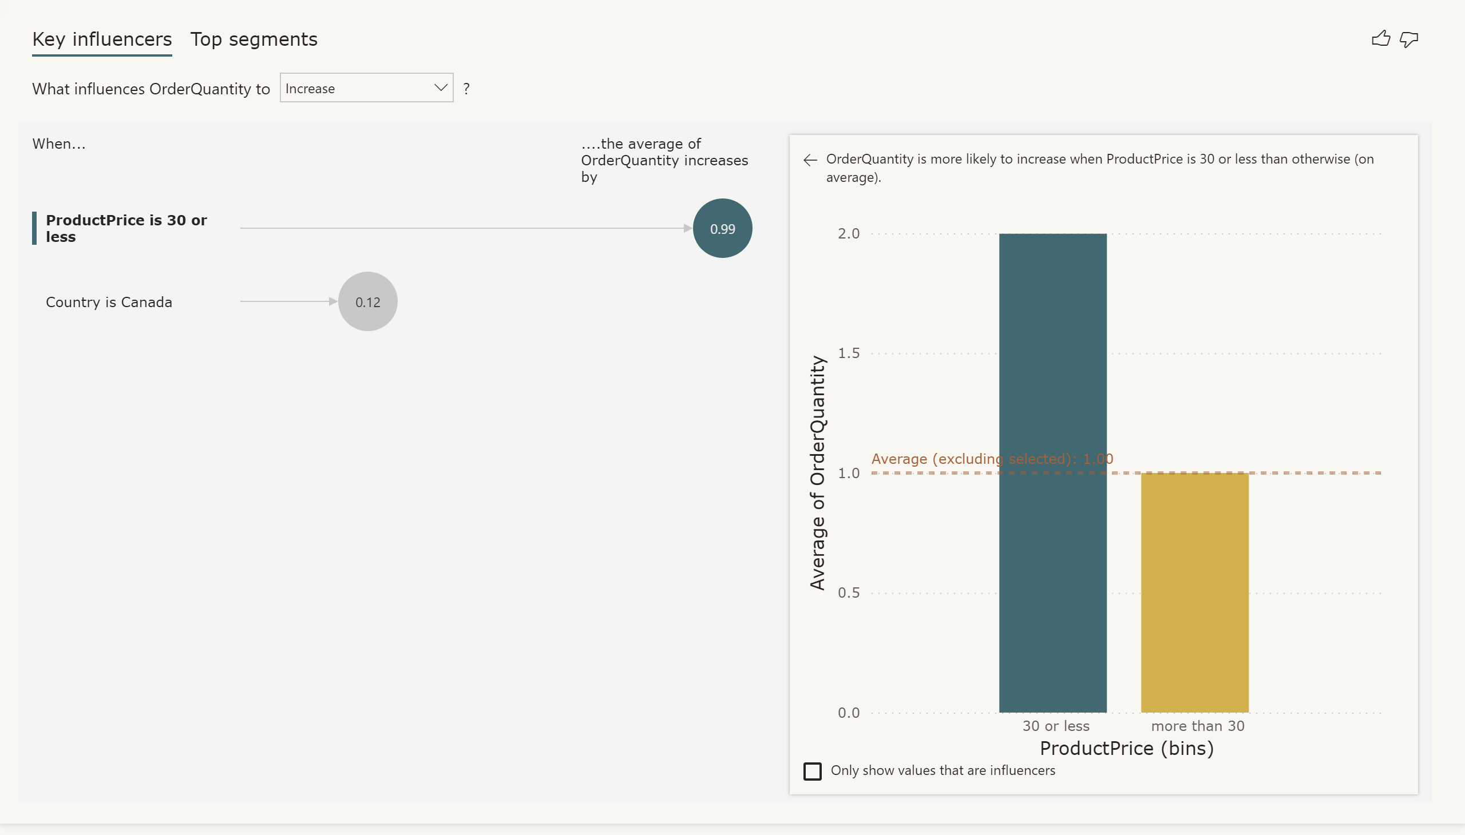
KI-1
Notes:
keyDriversVisual
No alt text provided.

Slide 6
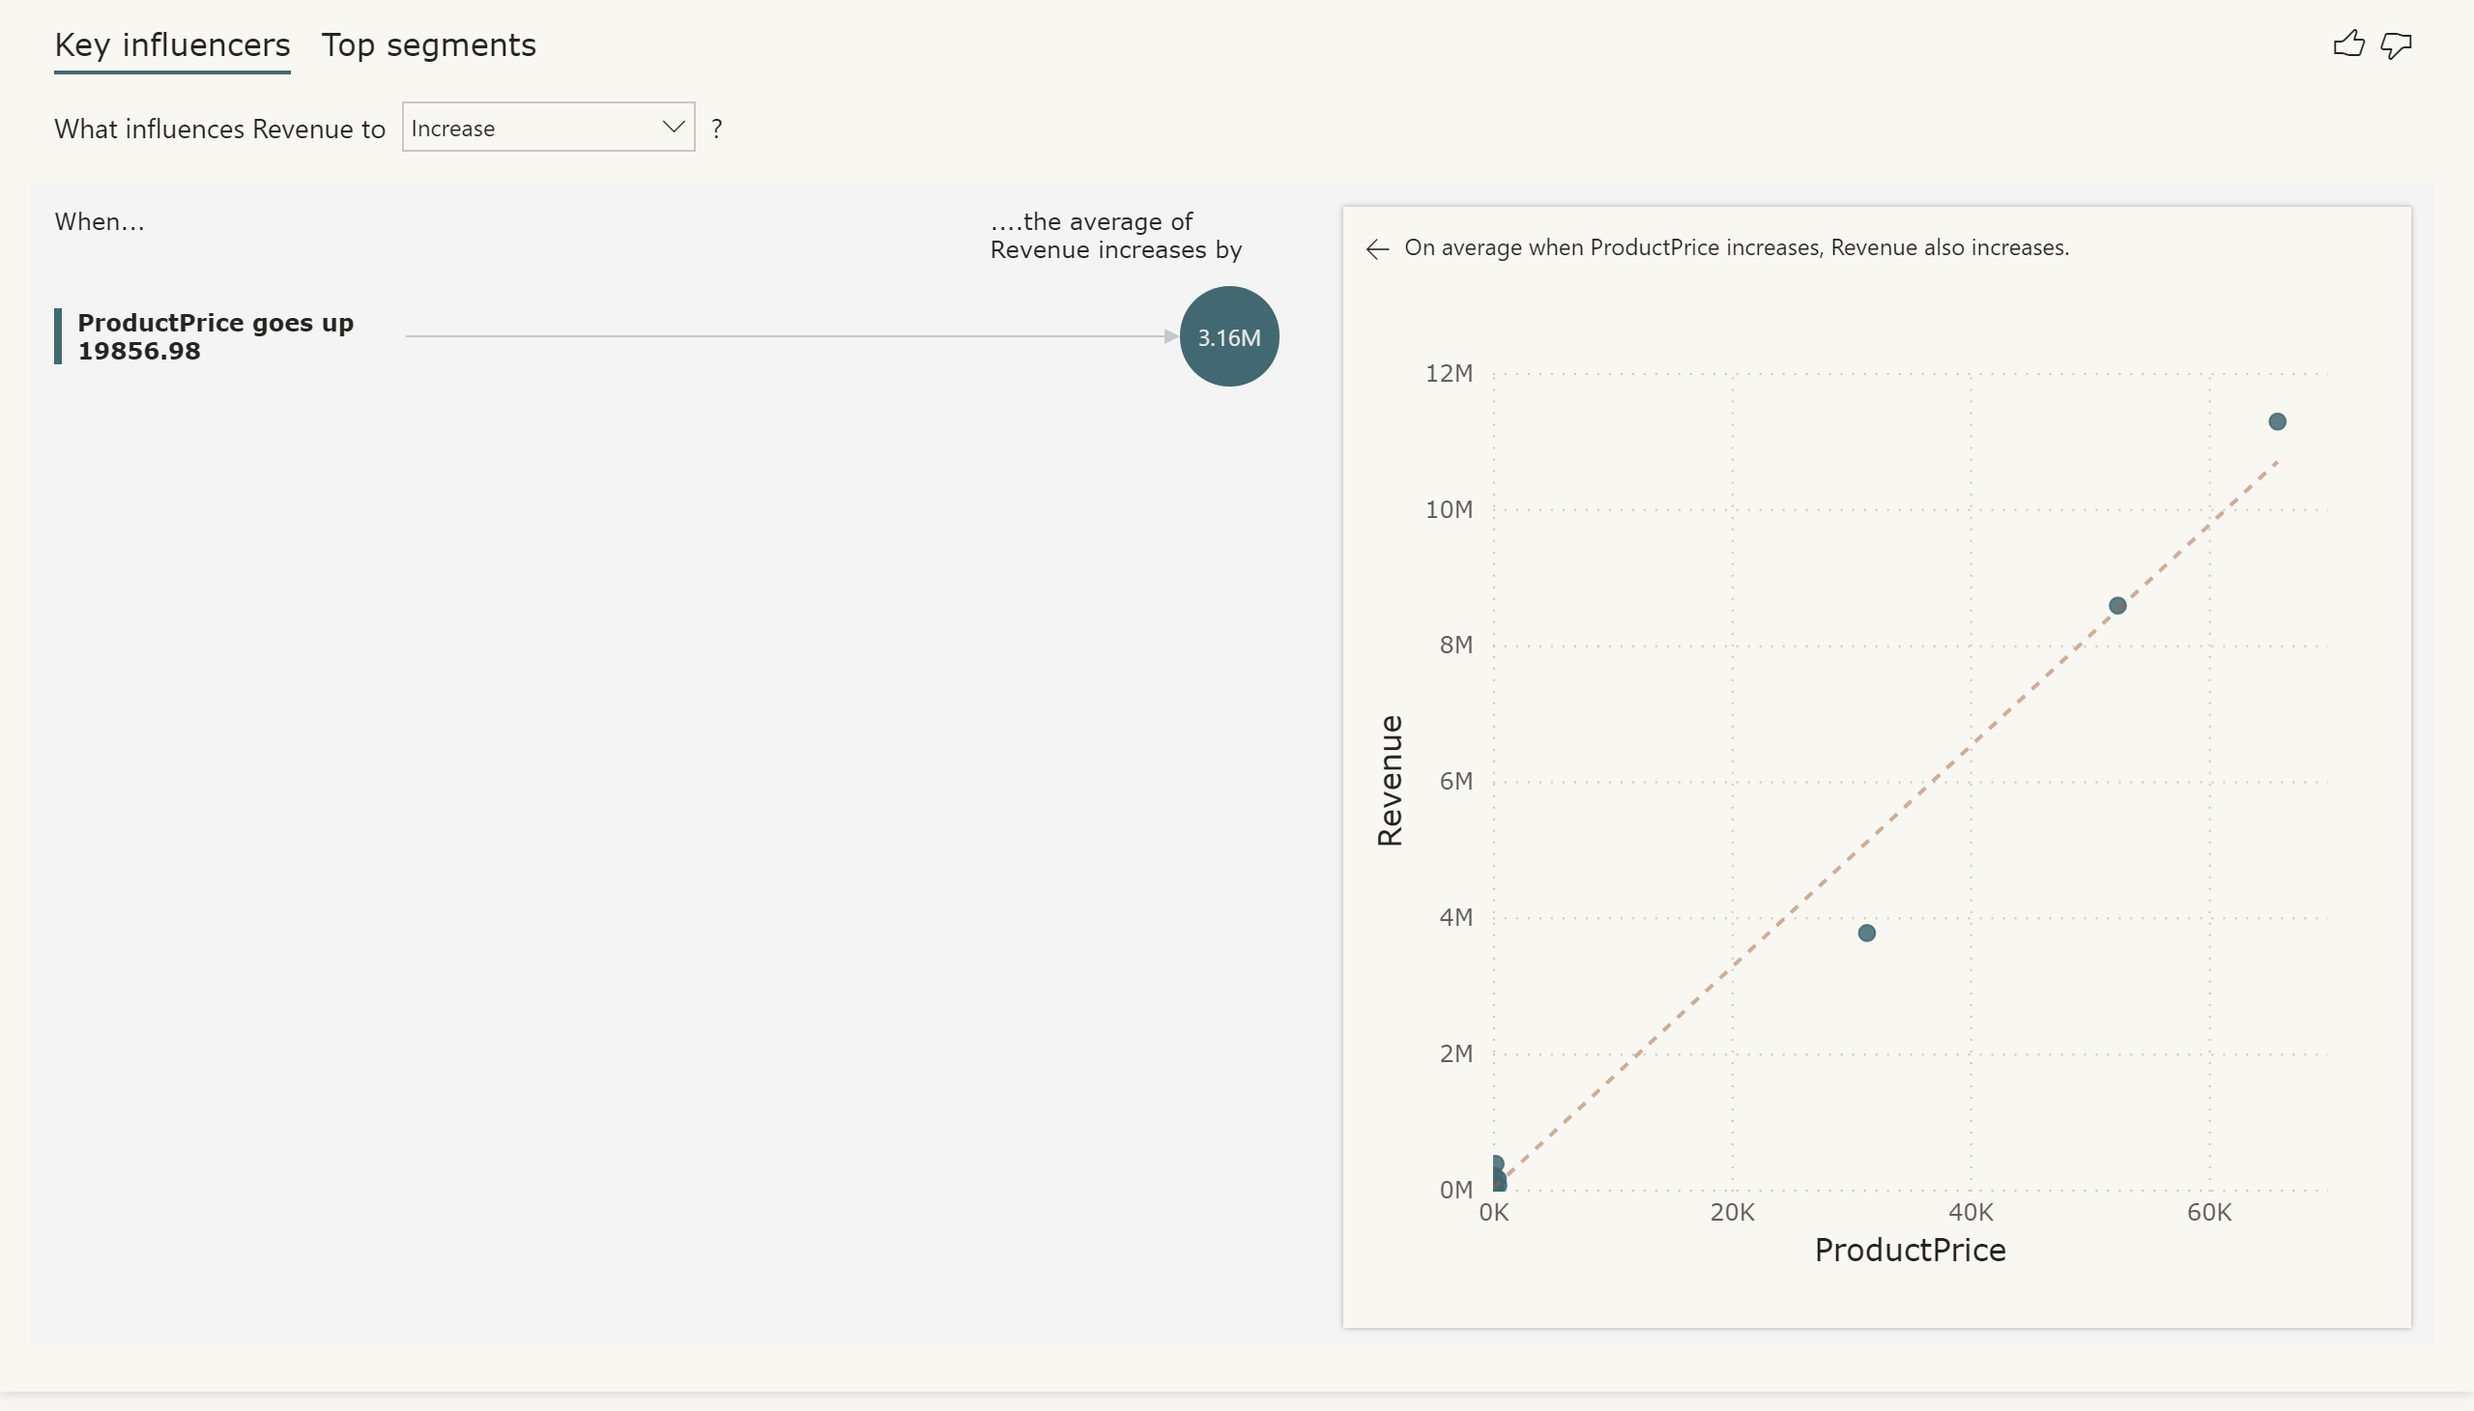
KI-2
Notes:
keyDriversVisual
No alt text provided.

Slide 7
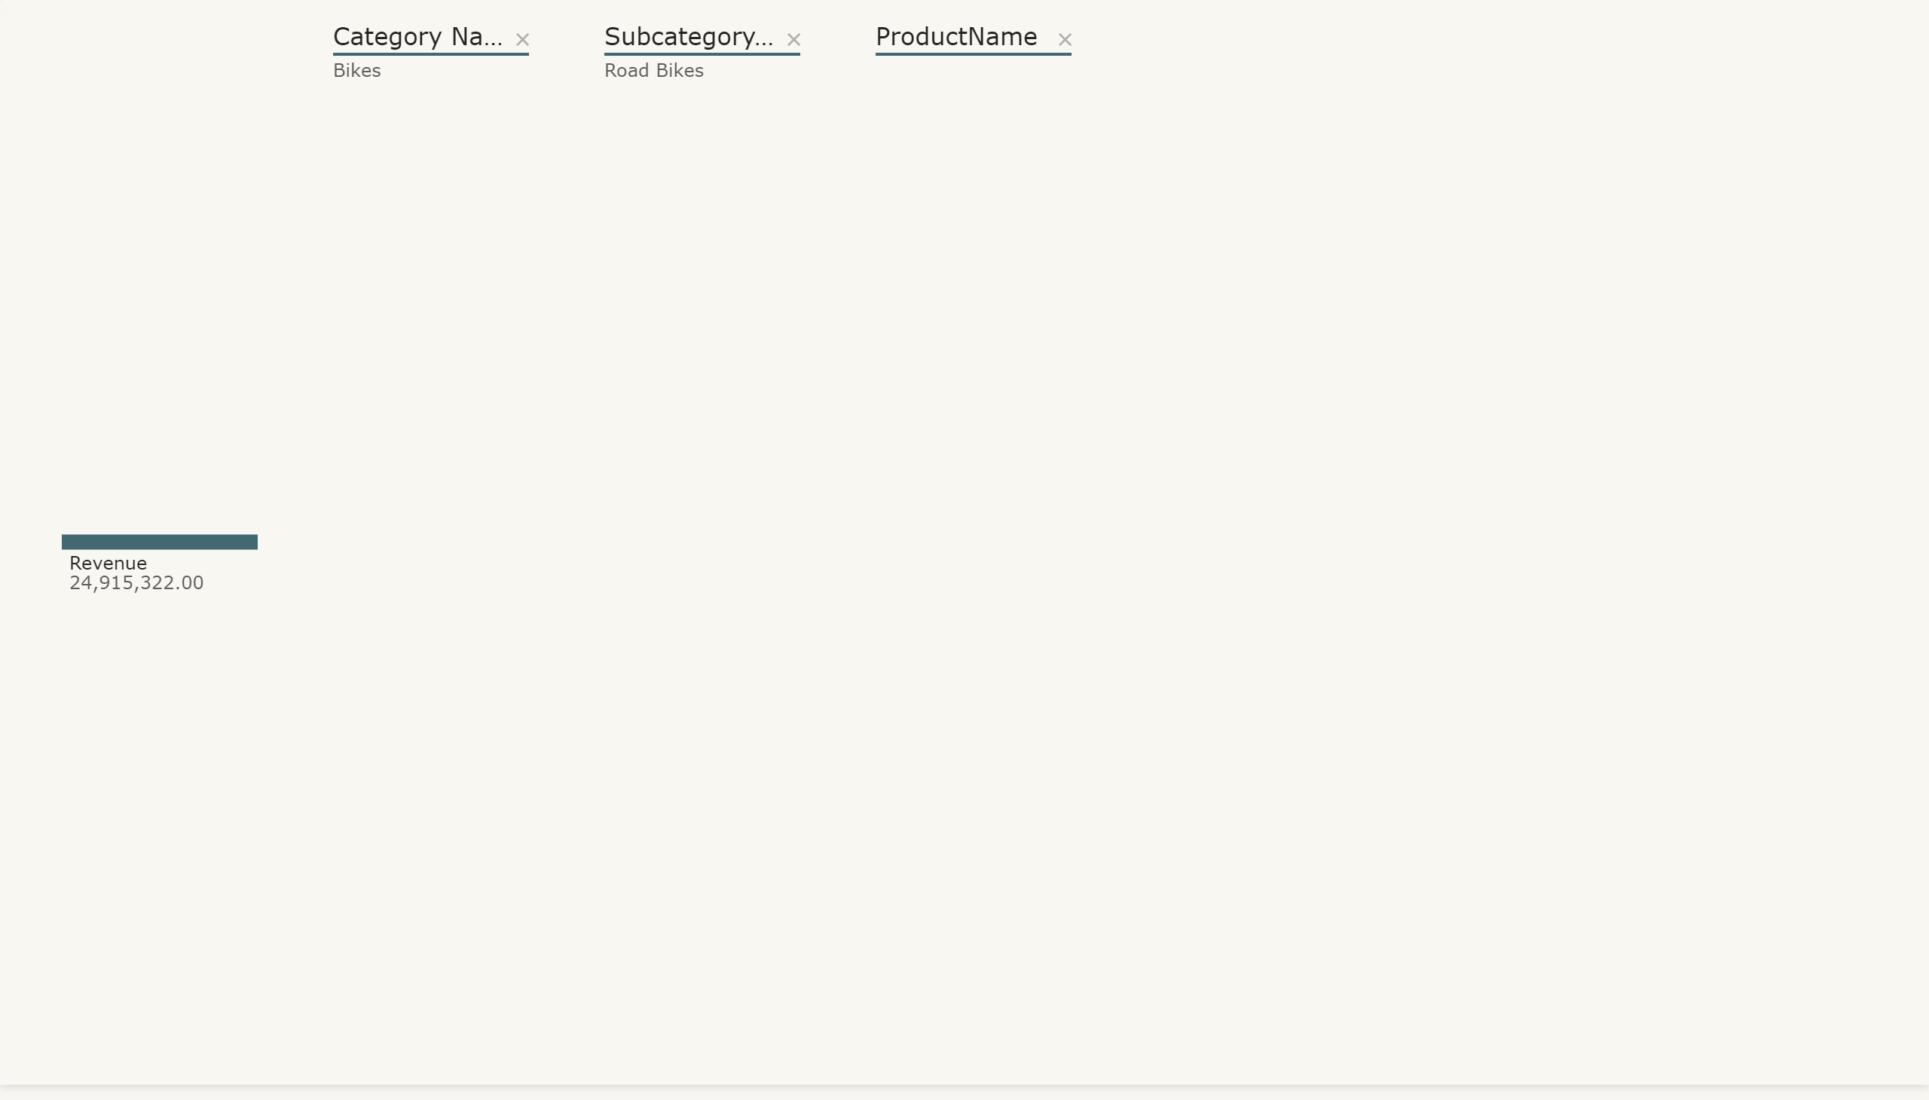
DT
Notes:
decompositionTreeVisual
No alt text provided.

Slide 8
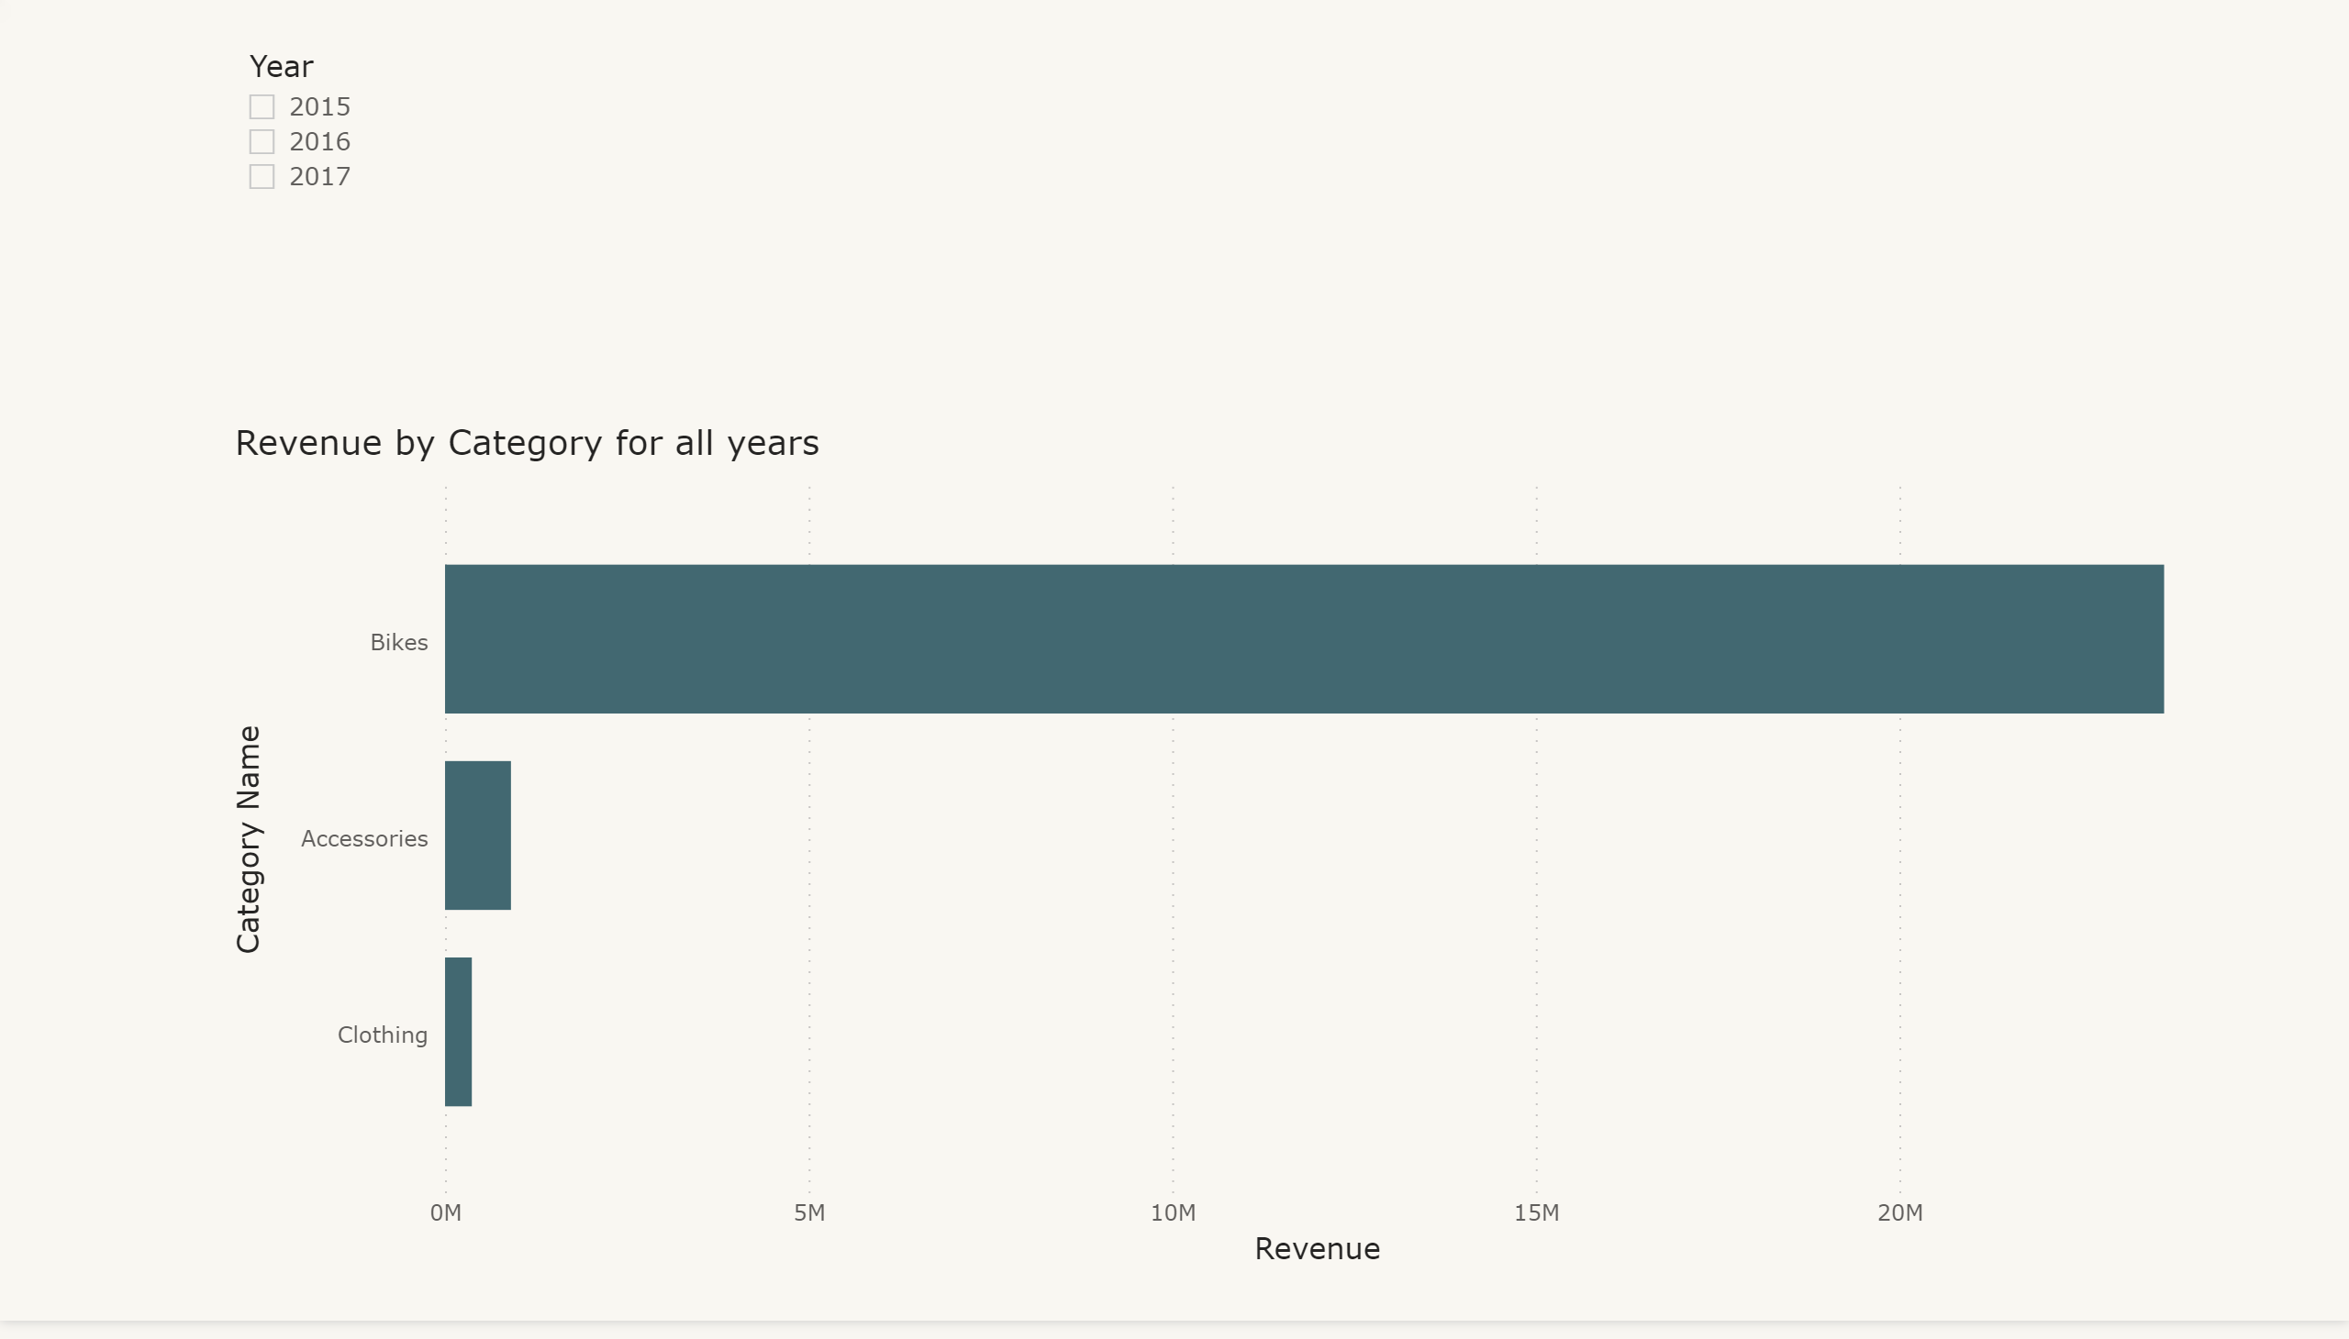
FBV
Notes:
Revenue by Category for all years
No alt text provided.
slicer
No alt text provided.

Slide 9
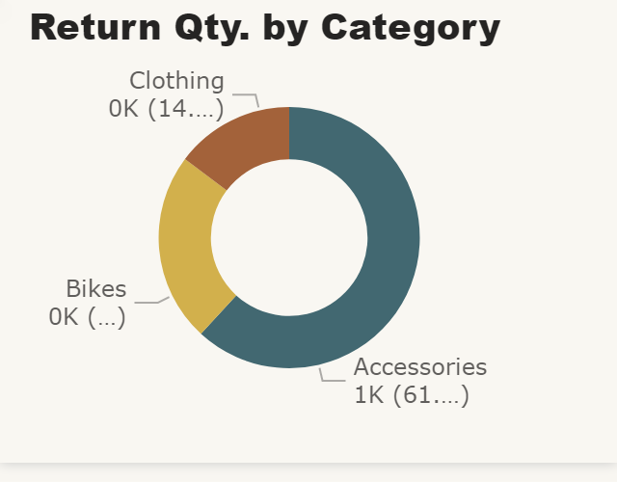
Tool Tip
Notes:
Return Qty. by Category
No alt text provided.

